Slide 1

Chapter 5:
Loops and Files

Slide 2

The Increment and Decrement
Operators
++ is the increment operator.
It adds one to a variable.
  int val = 10;
  val++; is the same as val = val + 1;
++ can be used before (prefix) or after (postfix) a variable:
  ++val; val++;

Slide 3
The Increment and Decrement
Operators
-- is the decrement operator.
It subtracts one from a variable.
  int val = 10;
  val--; is the same as val = val - 1;
-- can be also used before (prefix) or after (postfix) a variable:
  --val; val--;

Slide 4
Prefix vs. Postfix - Examples
int val = 12;
cout << val++; // displays 12,
// val is now 13
cout << ++val; // sets val to 14,
// then displays 14
cout << val--; // displays 14,
// sets val to 13
cout << --val; // sets val to 12,
// displays 12

Slide 5
5.2
Introduction to Loops

Slide 6
Introduction to Loops
Write a program that displays the numbers 1-3.
  cout << “1” << endl;
  cout << “2” << endl;
  cout << “3” << endl;
What if I ask you to print all the numbers from 1-100?

Slide 7
Introduction to Loops
Write a program to display “Hello World!”.
  cout << “Hello World” << endl;
What if now I ask you to write a program that displays “Hello World” 50 times?

Slide 8
Introduction to Loops
We need something that allows us to execute the same statement again and again
Loop: a control structure that causes a statement or statements to repeat
We will look at:
  while loop
  do-while loop
  for loop

Slide 9
The while Loop – How It Works
  General format of the while loop:
  while (expression)
  statement; // or block in { }
expression is evaluated
  if true, then statement is executed, and expression is evaluated again
  if false, then the loop is finished and program statements following statement execute

Slide 10
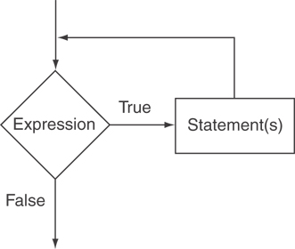
The Logic of a while Loop

Slide 11
The while Loop
Print numbers from 1-5 using while loop
int i =1;
while (i <= 5)
{
cout << i << endl;
i++;
}

Slide 12
The while Loop
Print “Hello” five times
int i =1;
while (i <= 5)
{
cout << “Hello World” << endl;
i++;
}

Slide 13
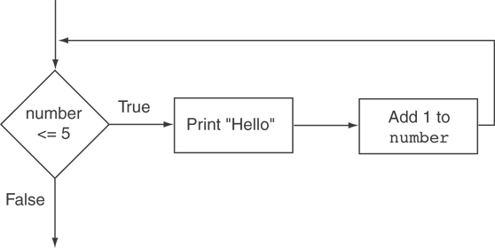
Flowchart of the while Loop

Slide 14
The while Loop is a Pretest Loop
expression is evaluated before the loop executes. The following loop will never execute:
int number = 6;
while (number <= 5)
{
cout << "Hello";
number++;
}

Slide 15
Watch Out for Infinite Loops
The loop must contain code to make expression become false
Otherwise, the loop will have no way of stopping
Such a loop is called an infinite loop, because it will repeat an infinite number of times

Slide 16
Example of an Infinite Loop
int number = 1;
while (number <= 5)
{
cout << "Hello\n";
}

Slide 17
Counter Variable
Counter: a variable that is incremented or decremented each time a loop repeats
Can be used to control execution of the loop (also known as the loop control variable)
Must be initialized before entering loop

Slide 18
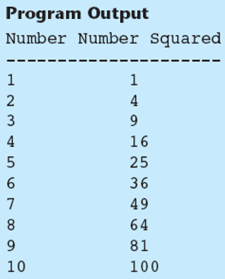
Exercise
Write a program that will display the numbers from 1-10 and the square of that number.

Slide 19
Exercise Solution
int number = 1;
while (number <= 10)
{
cout << number << "\t"
<< (number*number) << endl;
number++;
}

Slide 20
Exercise
Write a program that displays the characters for the ASCII code 33-126.

Slide 21
Exercise Solution
int number = 33;
while (number <= 126)
{
cout << static_cast<char>(number) << endl;
number++;
}

Slide 22
Exercise
For the previous exercise, display 10 characters on each line.

Slide 23
Exercise Solution
int number = 33;
int count = 0;
while (number <= 126)
{
  cout << static_cast<char>(number);
  number++;
  count++;
  if (count % 10 == 0)
  cout << endl;
}

Slide 24
5.3
Using the while Loop for Input Validation

Slide 25
Using the while Loop for Input Validation
Input validation is the process of inspecting data that is given to the program as input and determining whether it is valid.
  double radius;
  cout << "Enter a value for radius: ";
  cin >> radius;
  if (radius <= 0)
  cout << "Radius has to be greater than 0." << endl;

Slide 26
Using the while Loop for Input Validation
The while loop can be used to create input routines that reject invalid data, and repeat until valid data is entered.
  double radius;
  cout << "Enter a value for radius: ";
  cin >> radius;
  while (radius <= 0)
  {
  cout << "Please enter a value greater than 0: ";
  cin >> radius;
  }

Slide 27
Using the while Loop for Input Validation
Here's the general approach, in pseudocode:
Read the input value.
While the input is invalid
Display an error message.
Read the input again.
End While

Slide 28
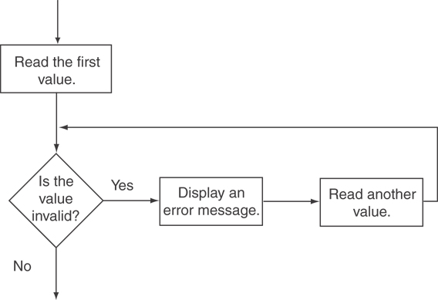
Flowchart for Input Validation

Slide 29
Exercise
Write a program that will ask the user to enter two numbers. Your program will display the sum of the two numbers. Your program will then ask the user if they would like to add another pair of numbers. If the user enters yes, ask the user to enter two numbers and then display the sum. Repeat the process until the user enters no.

Slide 30
Exercise Solution
double num1, num2;
char choice;
cout << "Enter two numbers: ";
cin >> num1 >> num2;
cout << "The sum is " << num1 + num2 << endl;
cout << "Would you like to add another pair of numbers? Enter y or n: ";
cin >> choice;
while (choice == 'y')
{
cout << "Enter two numbers: ";
cin >> num1 >> num2;
cout << "The sum is " << num1 + num2 << endl;
cout << "Would you like to add another pair of numbers? Enter y or n: ";
cin >> choice;
}

Slide 31
5.5
The do-while Loop

Slide 32
The do-while Loop
do-while: a posttest loop – execute the loop, then test the expression
General Format:
  do
  {
  statement;
  }while (expression);
Note that a semicolon is required after (expression)

Slide 33
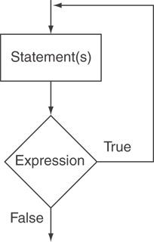
The Logic of a do-while Loop

Slide 34
An Example do-while Loop
int x = 1;
do
{
cout << x << endl;
} while(x < 0);
Although the test expression is false, this loop will execute one time because do-while is a posttest loop.

Slide 35
do-while Loop Notes
Loop always executes at least once
Execution continues as long as expression is true, stops repetition when expression becomes false
Useful in menu-driven programs to bring user back to menu to make another choice

Slide 36
Previous Exercise
Write a program that will ask the user to enter two numbers. Your program will display the sum of the two numbers. Your program will then ask the user if they would like to add another pair of numbers. If the user enters yes, ask the user to enter two numbers and then display the sum. Repeat the process until the user enters no.

Slide 37
Exercise Solution using While
double num1, num2;
char choice;
cout << "Enter two numbers: ";
cin >> num1 >> num2;
cout << "The sum is " << num1 + num2 << endl;
cout << "Would you like to add another pair of numbers? Enter y or n: ";
cin >> choice;
while (choice == 'y')
{
cout << "Enter two numbers: ";
cin >> num1 >> num2;
cout << "The sum is " << num1 + num2 << endl;
cout << "Would you like to add another pair of numbers? Enter y or n: ";
cin >> choice;
}

Slide 38
Solution using do-while loop
double num1, num2;
char choice;
do {
  cout << "Enter two numbers: ";
  cin >> num1 >> num2;
  cout << "The sum is " << num1 + num2 << endl;
  cout << "Would you like to add another pair of numbers? Enter y or n: ";
  cin >> choice;
} while (choice == 'y');

Slide 39
Exercise
Password Validation – Use do-while loop
Write a program that stores the password as “jaspers”. Now ask the user to enter the password. If the user enters invalid password, your program will display an error message and continue to ask the user for a valid password.
If the user enters the correct password, your program should display “Login Successful”

Slide 40
do-while Loop
// Password validation using do-while loop
string input, password = "jaspers";
do
{
cout << "Enter the password: " << endl;
getline(cin, input);
} while (input != password);
cout << "Login Successful!!" << endl;

Slide 41
Exercise
In the previous code, the user gets unlimited number of attempts to enter the correct password.
Modify the code so that the user only gets three attempts. After three attempts, the program displays “Login Unsuccessful!”

Slide 42
Solution
// Password validation using do-while loop with a maximum of three attempts
string input, password = "jaspers";
int attempts = 0;
do
{
cout << "Enter the password: " << endl;
getline(cin, input);
attempts++;
} while (input != password && attempts != 3);
if (input == password)
cout << "Login Successful!!" << endl;
else
cout << "Login Unsuccessful!!" << endl;

Slide 43
5.6
The for Loop

Slide 44
The for Loop
General Format:
for(initialization; test; update)
  statement; // or block in { }
How it works:
Perform initialization
Evaluate test expression
  If true, execute statement
  If false, terminate loop execution
Execute update, then re-evaluate test expression
Note: No semicolon after the update expression or after the )

Slide 45
for Loop - Example
Print Hello 5 times using while loop
int count =1;
while (count <= 5)
{
cout << “Hello” << endl;
count ++;
}
Print Hello 5 times using for loop
int count;
for (count = 1; count <= 5; count ++)
  cout << “Hello” << endl;
Note: You can also declare count in the initialization expression.

Slide 46
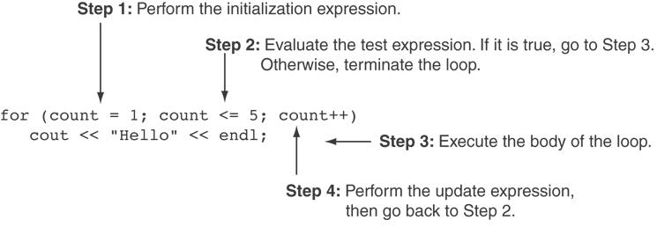
for Loop - Example

Slide 47
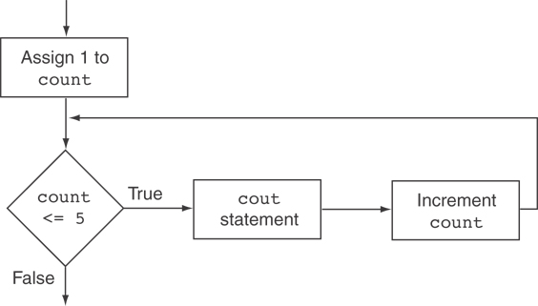
Flowchart for the Previous Example

Slide 48
Exercise
Write a program that will display the numbers from 1-10 and the square of that number. Use for loop.

Slide 49
Exercise Solution
for (int i = 1; i <= 10; i++)
{
cout << i << "\t" << (i*i) << endl;
}
The above code using while loop:
int i = 1;
while(i <= 10)
{
cout << i << "\t" << (i*i) << endl;
i++;
}

Slide 50
5.7
Keeping a Running Total

Slide 51
Keeping a Running Total
running total: accumulated sum of numbers from each repetition of loop
accumulator: variable that holds running total
  int sum = 0;
  for (int num = 1; num <= 5; num++)
  {
  sum += num;
  }
  cout << sum << endl;

Slide 52
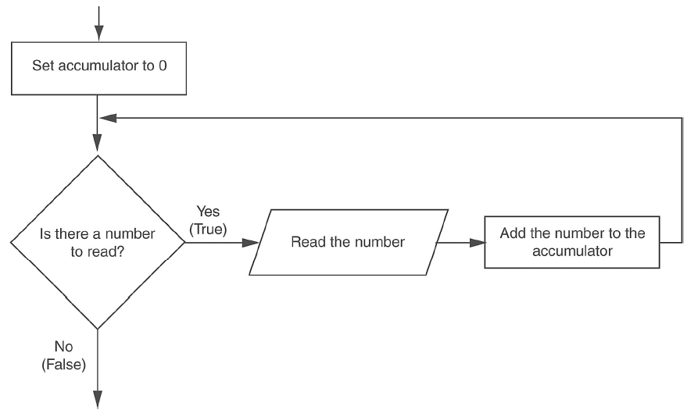
Logic for Keeping a Running Total

Slide 53
Exercise
Using for loop, write a program that will ask the user for five scores, Your program should then add those scores and display the sum and average.

Slide 54
Exercise
Solve the previous problem using a while loop.

Slide 55
Exercise
Now, instead of the user being limited to entering 5 scores, write a program that will let them enter as many scores as they want.

Slide 56
5.8
Sentinels

Slide 57
Sentinels
sentinel: value that indicates end of data
Special value that cannot be confused with a valid value, e.g., -999 for a test score
Used to terminate input when user may not know how many values will be entered

Slide 58
Sentinels
int sum = 0, num;
cout << "Enter scores to add, enter -1 when done: ";
cin >> num;
while (num != -1)
{
sum += num;
cout << "Enter another score: ";
cin >> num;
}
cout << "The total is " << sum << endl;

Slide 59
5.9
Deciding Which Loop to Use

Slide 60
Deciding Which Loop to Use
The do-while loop is a conditional posttest loop
  Always iterates at least once
  Repeating a menu
The while loop is a conditional pretest loop
  Iterates as long as a certain condition exits
  Validating input
  Reading lists of data terminated by a sentinel
The for loop is a pretest loop
  Built-in expressions for initializing, testing, and updating
  Situations where the exact number of iterations is known

Slide 61
5.10
Nested Loops

Slide 62
Nested Loops
A nested loop is a loop inside the body of another loop
Inner (inside), outer (outside) loops:

Slide 63
What will be the output?
int i, j;
for (i=1; i<=5; i++)
{
for (j=1; j<=i; j++)
{
cout << "*";
}
cout << endl;
}

Slide 64
What will be the output?
int i, j;
for (i=1; i<=5; i++)
{
for (j=1; j<=i; j++)
{
cout << "*";
}
cout << endl;
}
    Output
    *
    **
    ***
    ****
*****

Slide 65
What will be the output?
int i, j;
for (i=1; i<=5; i++)
{
for (j=i; j<=5; j++)
{
cout << "*";
}
cout << endl;
}

Slide 66
for Loop - Example
int i, j;
for (i=1; i<=5; i++)
{
for (j=i; j<=5; j++)
{
cout << "*";
}
cout << endl;
}
    Output
    *****
    ****
    ***
    **
    *

Slide 67
Nested for Loop - Example
Write a program that will ask the user for the number of students and the number of tests.
Now, ask the user to enter the test scores of each student, then find the average of the score for each student and display the average.

Slide 68
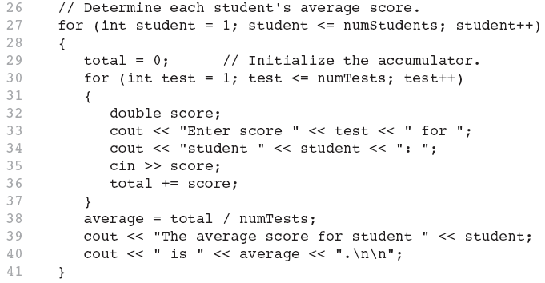
Nested for Loop Solution
Inner Loop
Outer Loop

Slide 69
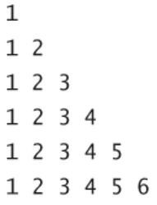
Nested for Loop - Example
Write a program that will display the following pattern:

Slide 70
Nested for Loop - Solution
Write a program that will display the following pattern:
for (int i = 1; i <= 6; i++)
{
for (int j = 1; j <= i; j++)
cout << setw(3) << j;
cout << endl;
}

Slide 71
5.12
Breaking and Continuing a Loop

Slide 72
Breaking Out of a Loop
Can use break to terminate execution of a loop
Can use continue to go to end of loop and prepare for next repetition
Use sparingly – can make program logic hard to follow

Slide 73
5.11
Using Files for Data Storage

Slide 74
Using Files for Data Storage
Can use files instead of keyboard, monitor screen for program input, output
Allows data to be retained between program runs
Steps:
  Open the file
  Use the file (read from, write to, or both)
  Close the file

Slide 75
Files: What is Needed
Use fstream header file for file access
The header file defines three data types:
ofstream | Output file stream. You create an object of this data type when you want to create a file and write data to it.
ifstream | Input file stream. You create an object of this data type when you want to open an existing file and read data from it.
fstream | File stream. Objects of this data type can be used to open files for reading, writing, or both.

Slide 76
Opening Files
Create a file stream object
  ifstream infile;
  ofstream outfile;
Create a link between file name and file stream object using open member function:
  infile.open(“data.txt”);
  outfile.open(“report.txt”);
Filename may include drive, path info.
Input file must exist for open to work
Output file will be created if necessary; existing file will be erased first

Slide 77
Testing for File Open Errors
Can test a file stream object to detect if an open operation failed:
  ifstream infile;
  infile.open("test.txt");
  if (!infile)
  {
  cout << "File could not be opened!";
  }

Slide 78
Closing Files
Use the close member function:
  infile.close();
  outfile.close();
Don’t wait for operating system to close files at program end:
  may be limit on number of open files
  may be buffered output data waiting to send to file

Slide 79
Program 5-17: Writing to a file
ofstream outputFile;
outputFile.open("C:\\Users\\AA\\Desktop\\Numbers.txt");
int number1, number2, number3;
cout << "Enter three numbers: ";
cin >> number1 >> number2 >> number3;
// Write the numbers to the file.
outputFile << number1 << endl;
outputFile << number2 << endl;
outputFile << number3 << endl;
// Close the file
outputFile.close();

Slide 80
Program 5-20: Reading from a file
ifstream inFile;
inFile.open("C:\\Users\\AA\\Desktop\\Numbers.txt");
int value1, value2, value3, sum;
// Read the three numbers from the file.
inFile >> value1 >> value2 >> value3;
// Close the file.
inFile.close();
// Calculate the sum of the numbers.
sum = value1 + value2 + value3;
// Display the three numbers.
cout << "Here are the numbers:\n" << value1 << " " << value2 << " " << value3 << endl;
// Display the sum of the numbers.
cout << "Their sum is: " << sum << endl;

Slide 81
Program 5-22: Detecting the end of the file
ifstream inFile;
int value, sum = 0;
string fileName = "C:\\Users\\AA\\Desktop\\Numbers.txt";
inFile.open(fileName);
while (inFile >> value)
{
cout << value <<endl;
sum = sum + value;
}
// Close the file.
inFile.close();
// Display the sum of the numbers.
cout << "The sum is: " << sum << endl;

Slide 82
Class Exercise 1
Write a program that generates 20 random numbers between 10 and 15 and stores them in a text file called “Numbers.txt” on your desktop.

Slide 83
Class Exercise 2
Read the text file that you created in the previous example. Count the number of values less than equal to 12 and the number of values greater than 12. Display these two counts.

